Slide 1

Concurrency Making code fast with threads
CS 1181 – Computer Science II
Dr. Michael Raymer
Lecture materials adapted from:
ZyBooks ISBN: 979-8-203-16123-9 Dr. Cay Horstmann, Univ. of Michigan Dr. Roman Lysecky, Univ. of Arizona
Dr. Adrian Lizarraga, Univ. of Arizona
Dr. Travis Doom
Dr. Michelle Cheatham
Unless otherwise noted images are used under the creative commons license or used under license from Adobe Stock.

Slide 2
Temp = nextJob;
Array[temp]++;
nextJob ++;

Slide 3


How do computers run many programs at the same time?
1) Multiple cores
2) Pre-emptive multitasking

Slide 4
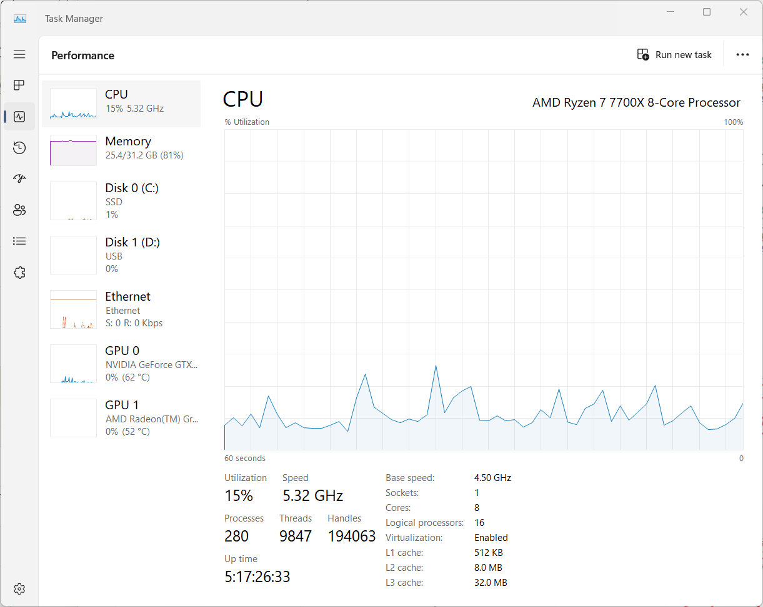
Execution Cores

Slide 5
Processes
A process consists of:
Memory Space
Heap
Stack
Globals/Statics
Code
Program State
Program counter
Execution state: Running, waiting, sleeping, etc.
Each program executes as a single process.

Slide 6
Threads
An execution thread (sometimes called a lightweight process) is a sequence of instructions being executed.
Threads share memory space but have their own stack frames. A process can have multiple threads.
So far, we’ve only seen one or two execution threads* running at a time, but no more…
* Remember the Event Dispatch Thread?
Notes:
Imagine departments in a company.

Slide 7
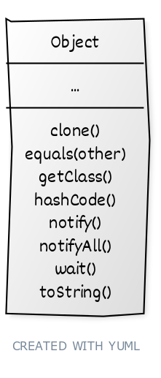
Threads in Java
Concurrency and threads are a core part of the java language (no import required!)

Slide 8
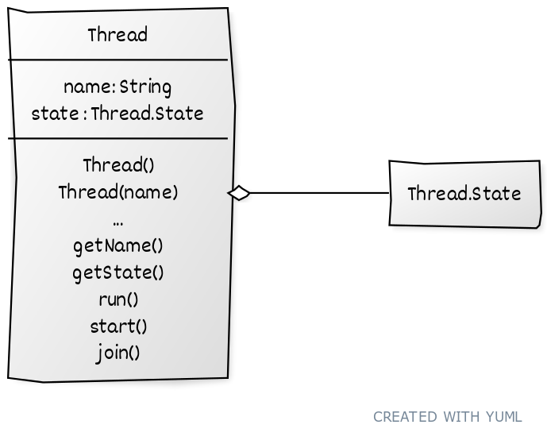
Class Thread
NEW
RUNNABLE
BLOCKED
WAITING
TIMED_WAITING
TERMINATED

Slide 9
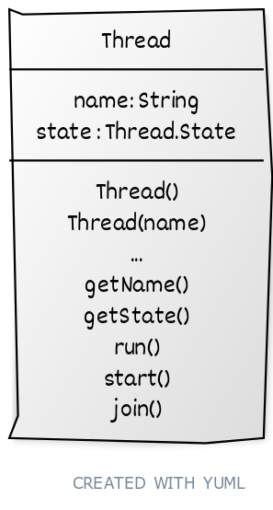
Class Thread
run()
An ordinary method. Nothing special about it (almost). Put your code here!
start()
Creates a new execution thread and starts executing run() in it.

Slide 10
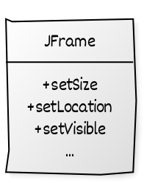
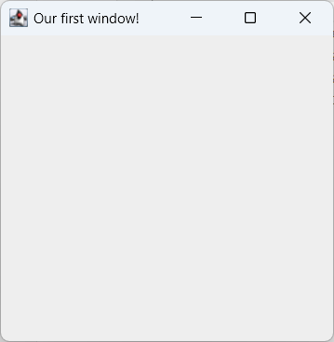
Thread Objects and Execution Threads
while (window-open){
if (button-clicked){
do something;
}
else if (window-resized){
do something;
}
else if …
}

Slide 11

Example
public class NumberCounter extends Thread{
public void run(){
for (int i = 0; i < 20; i++){
System.out.println(i);
}
}
}
What went wrong?
public class LetterCounter extends Thread{
public void run(){
for (char c = 'a'; c <= 'z'; c++){
System.out.println(c);
}
}
}
public class Main {
public static void main(String[] args) {
LetterCounter t1 = new LetterCounter();
NumberCounter t2 = new NumberCounter();
t1.run();
t2.run();
System.out.println("Main is done");
}
}
t1.start();
t2.start();

Slide 12


Thread States
NEW
No execution thread. start() hasn’t been called yet.
RUNNABLE
Execution thread is running or waiting for the OS to run it.
BLOCKED
WAITING
Waiting for another thread to wake me.
TIMED_WAITING
Waiting for a fixed amount of time to wake.
TERMINATED
Execution thread is finished.

Slide 13

Thread States
Thread t1 = new Thread(“thread1”);
public void run(){
for (int i = 0; i < 20; i++){
System.out.println(i);
}
}
name: “thread1”
state: TERMINATED
state: NEW
state: RUNNABLE
run() finishes execution
t1.start();

Slide 14
join()
join()
Wait for a thread to reach the TERMINATED state, then move on to the next instruction.

Slide 15
Ok, so when should I use this?
When you want things running independently.
For example, if you want an animation running while a file downloads.
Games often require multiple threads for smooth play.
When you have a lot of work to do.
Divide up into parts and run one thread on each part

Slide 16

Threads for sharing work
public static int work[];
thread1
99090368
35740991
15148380
96987426
59204130
23039301
51680137
15953848
87410394
92339830
87251519
83043397
98903373
5794269
63822957
35504921
2500009
35772966
97043882
32265892
44770899
47413523
8487743
6323422
3629299
thread2
thread3
thread4
thread5

Slide 17
When jobs are unequal in size
public static int work[];
public static int nextJob = 0;
thread2
thread1
99090368
35740991
15148380
96987426
59204130
23039301
51680137
15953848
87410394
92339830
87251519
83043397
98903373
5794269
63822957
35504921
2500009
35772966
97043882
32265892
44770899
47413523
8487743
6323422
3629299
thread3
thread4
thread5

Slide 18
What went wrong?

Slide 19


Looking behind the curtain
ILOAD 1
ILOAD 2
IADD
ISTORE 3
k = i + j;

Slide 20


Warnings
Even the simplest instruction is made up of smaller bytecode (or machine code) instructions.
Your code can be by the operating system at any time.
Img src: https://sackisback.fandom.com/wiki/Frozen
Notes:
Class exercise: Be the CPU.

Slide 21

Class exercise:
Executing concurrent code

Slide 22
Temp = nextJob;
Array[temp]++;
nextJob++;

Slide 23

Race Conditions
A race condition occurs when the program can have different (incorrect) output, depending on when each thread runs.

Slide 24
So, how do we fix it?
It should be ok for different threads to work on different elements of work[] at the same time.
We need to make sure different threads are not using/changing nextJob at the same time!

Slide 25


Java monitors
Every object in Java has a monitor, which acts as a lock/stoplight controlling access to some sections of code.

Slide 26
Synchronize
When we use the Java keyword Synchronized, we tell Java than only one thread can be running the code at a time.
If a thread is frozen while running a Synchronized method, all other threads are locked out until the frozen method wakes up and finishes.

Slide 27

Example
Worker
Manager
public void run(){
nextJob = myManager.getNextJob();
…
}
nextJob = 0;
work[];
87410394
92339830
87251519
83043397
98903373
5794269
63822957
35504921
2500009
35772966
97043882
32265892
∙∙∙
Worker
public void run(){
nextJob = myManager.getNextJob();
…
}
Worker
public void run(){
nextJob = myManager.getNextJob();
…
}
Worker
public void run(){
nextJob = myManager.getNextJob();
…
}
getNextJob();
storeResult();

Slide 28
Which methods to Synchronize?
We synchronize getNextJob() because many threads are using the same variable (communication!)
What happens if I synchronize doWork()?

Slide 29
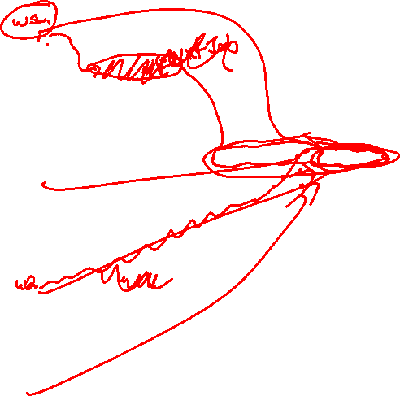
Volatile Variables and Cache
23039301
0000
0001
0002
0003
0004
0005
0006
0007
0008
0009
0010
0011
0012
0013
0014
0015
0016
0017
0018
0019
0020
0021
0022
0023
0024
99090368
35740991
15148380
96987426
59204130
23039301
51680137
0000013
87410394
92339830
87251519
83043397
98903373
5794269
63822957
35504921
2500009
35772966
97043882
32265892
44770899
47413523
8487743
6323422
3629299
51680137
0000013
87410394
92339830
87251519
nextJob:
23039301
51680137
0000013
87410394
92339830
87251519

Slide 30
Volatile variables
The volatile keyword in java ensures that a variable is:
Not cached
Always accessed in a synchronized fashion
It can be used to replace a synchronized method, but take care, as it will slow down your code significantly.

Slide 31

Multiple Inheritance
Suppose I want to make a class called Clock that puts a working clock into a GUI.
I probably want to inherit from class Component, or maybe JPanel.
How can I give the Clock its own execution thread?

Slide 32
Interface Runnable
The Runnable interface requires you to implement just one method:
This allows us to give any class its own execution thread.
We can even use a lambda expression!
public void run(){}
Notes:
Quick lambda expression example.

Slide 33
Using a Runnable
You can create a Thread that is “linked” to a Runnable object, and will use that object’s run() method when start() is called:
Thread t1 = new Thread(myClock);
t1.start();
myClock
t1
start(){
run(){}

Slide 34


Example
public class CounterButton extends JButton implements Runnable{
t1
start(){
public void run(){
for (int i = 0; i < 5; i++){
System.out.println(i);
try{
Thread.sleep(1000);
} catch (InterruptedException e){
e.printStackTrace();
}
}
}
t2
start(){
t3
start(){

Slide 35
Quiz Password:
divide

Slide 36
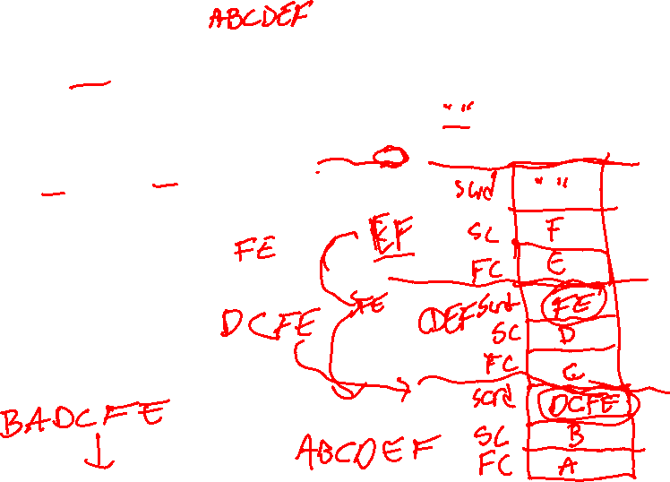
public static String scramble(String theString){
if (theString.length() <= 1){
return theString;
}
String firstChar = theString.substring(0, 1);
String secondChar = theString.substring(1,2);
String scrambled = scramble(theString.substring(2));
return(secondChar + firstChar + scrambled);
}

Slide 37
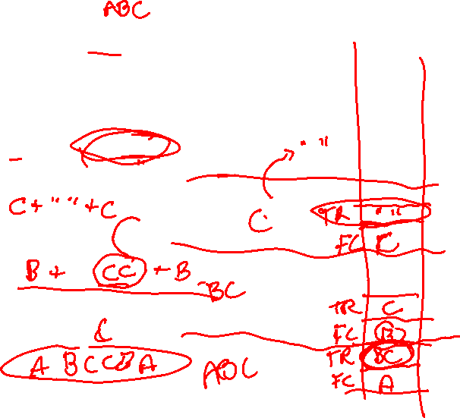
public static String pal(String theString){
if (theString.length() == 0){
return theString;
}
else{
String firstChar = theString.substring(0,1);
String theRest = theString.substring(1);
return(firstChar + pal(theRest) + firstChar);
}
}

